Slide 1

KasiMath
01

Slide 2

Many learners struggle with basic math concepts (fractions, algebra, arithmetic).
Traditional teaching methods feel boring, abstract, and stressful.
Weak math foundations affect confidence, exam results, and future careers.
10

Slide 3
Solution
KasiMath App: A fun, interactive platform to help learners master math basics.
Features:
Gamified lessons 🎮
Step-by-step explanations
Adaptive quizzes 📊
Real-world examples (shopping, cooking, sports)
Progress tracking & personalized feedback
06

Slide 4
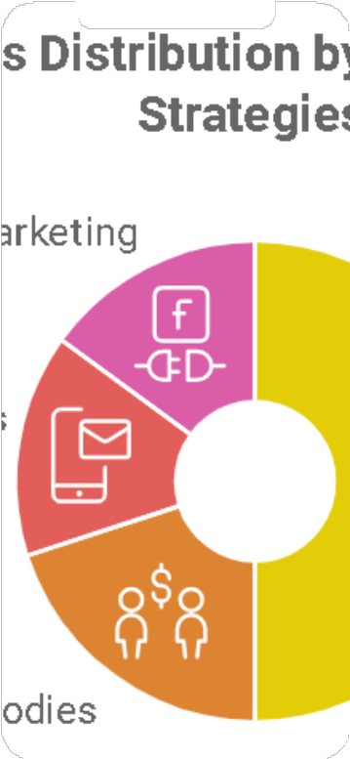


Product
Dashboard with progress bar
Interactive lesson (e.g., “Fractions with Pizza 🍕”)
Rewards system (badges, stars)
Analytics for parents/teachers
04

Slide 5
Target Market
.
Primary: Students aged 8–18 (primary & high school)..
Secondary: Parents & teachers looking for effective learning tools.
Global edtech market = R7.064 trillion + by 2030 📈.
.
14

Slide 6
Market Size
South African EdTech Market (2024)
Overall: ~ZAR 16.4 billion
Pre-K to K-12-focused: ~ZAR 10.0 billion
Online (Digital) Learning Sub-Sector
Base: ~ZAR 7.0 billion — this is your immediate addressable digital market.
Projected Growth Trajectory
Online education expected to grow rapidly (CAGR ~24%), reaching multiple times its current size by 2033.
Expansion Potential
Corporate e-learning: A substantial ZAR 17.3 billion in 2024—with high growth potential through to 2030.

Slide 7
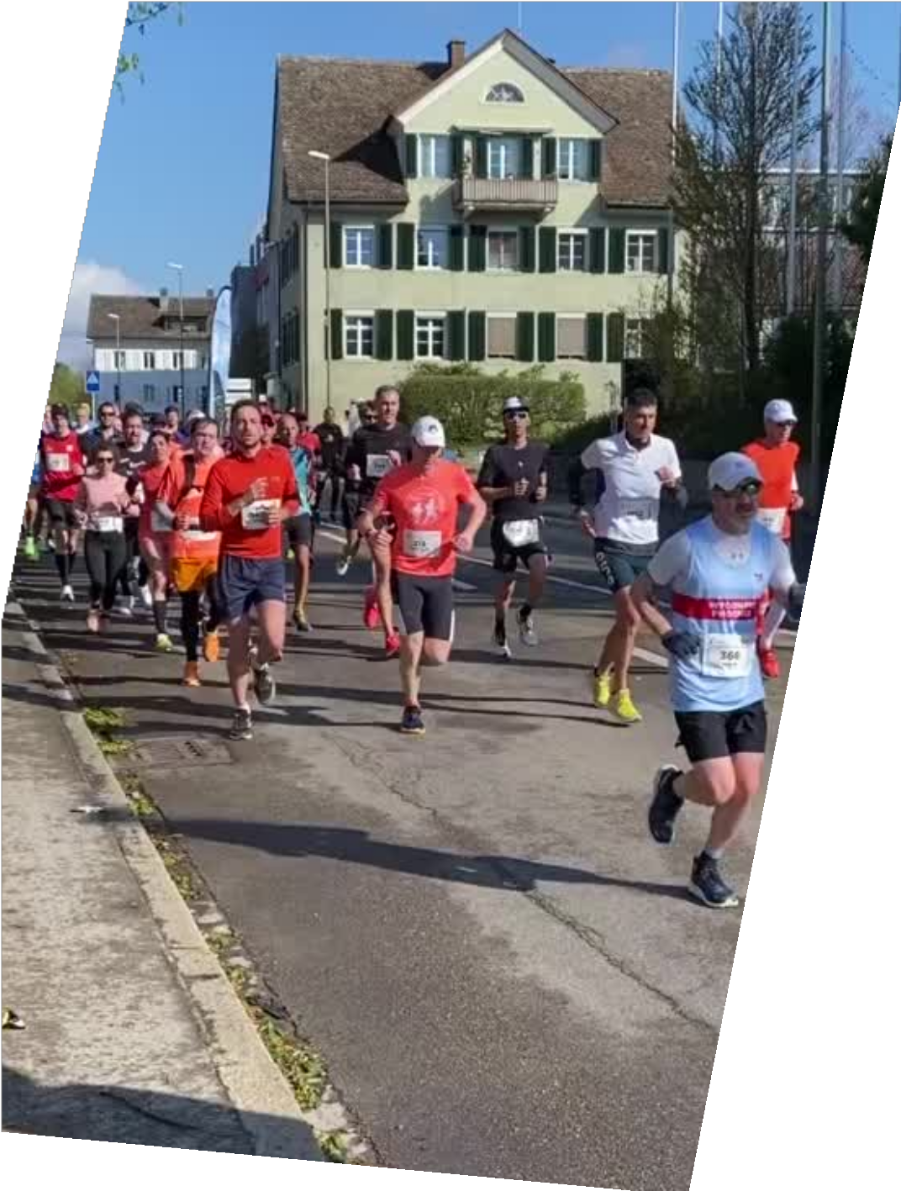
Competitors
Khan Academy (Global)
Free, high-quality lessons.
Strong brand, but lacks local curriculum alignment.
BYJU’S / Toppr (India, Global reach)
Highly gamified & adaptive learning.
Subscription is expensive, less focus on African learners.
Photomath (Global, popular in SA)
Snap a photo, get step-by-step solutions.
Great for homework help, but not for conceptual understanding.
Siyavula (South Africa)Curriculum-aligned math/science practice.Text-heavy, less engaging for younger learners.
23

Slide 8
Competitive Advantage
Other apps: Focus on memorization.
KasiMath difference:Interactive storytelling
Adaptive learning AI 🤖
Offline access for low-data areas 🌍
Localized for school curriculums?

Slide 9
Project Traction
Tasks
Month 1
Month 2
Month 3
Month 4
Month 5
Prototype ready ✅
Beta testing in 2 schools
🚀Next: Launch in app stores, scale regionally
Future: AI tutor, AR/VR math labs
23

Slide 10
Business Model
Freemium model:
Free: Basic lessons & quizzes
Premium ($4.99/month):Full access, advanced analytics, multiplayer challenges
School partnerships (bulk licenses)
23

Slide 11
Go To Market
Launch in schools (pilot programs)
Partner with education NGOs & government
Social media campaigns 🎯
Parent/teacher influencer endorsements

Slide 12
Social Impact
SDG 4 – Quality Education
Ensure inclusive and equitable quality education and promote lifelong learning opportunities for all
.How KasiMath contributes:
Makes math basics accessible and engaging for learners.
Provides equal access to digital learning, even in low-data areas.
Supports teachers with extra tools for classrooms.
SDG 10 – Reduced Inequalities (secondary impact)
Reduce inequality within and among countries.
How KasiMath contributes:
Affordable freemium model ensures access for low-income learners.
Offline-first design helps bridge the urban–rural digital divide.
SDG 8 – Decent Work & Economic Growth (long-term impact)
Promote sustained, inclusive and sustainable economic growth.
How KasiMath contributes:
Builds stronger STEM foundations → better career opportunities.
Equips youth with problem-solving skills for future jobs.

Slide 13

Our Ask
Seeking $250,000 seed funding to:
Develop app fully
Marketing & partnerships
Curriculum integration
Vision: To reach 1 million learners in 3 years.

Slide 14

Team Members
Nhlanhla Makhubu
App Developer and Owner

Slide 15
Thank you!
0780189149, social media accounts
17

